Slide 1
COS 212 Sorting: Shell Sort and Heap Sort

Slide 2
Intuitive Sorting Algorithms are Slow
Why are the intuitive sorting algorithms so slow?
Always involves a nested loop, bringing complexity up to O(n²)
Can we alleviate this quadratic bane?
Let’s look at an example
This array contains 8 elements
If sorting has O(n²) complexity, then t(n) = n², and t(8) = 64
What if we split the array in two halves?
Using the same algorithm to sort the halves separately
For each half of the array, t(4) = 16
Therefore, for the entire array, t(4) x 2 = 32
Much less time complex than sorting the whole array!
6 | 7 | 2 | 1 | 5 | 8 | 3 | 4
6 | 7 | 2 | 1
5 | 8 | 3 | 4

Slide 3
Efficient sorting
However… sorting each half does not sort the entire array!
But it does bring the array closer to a fully sorted array
Arrays can be subdivided in many ways – not just halved
Let’s consider comb sort again
Compare elements that are m places apart
Value of m is called a gap
The gap shrinks non-linearly for each pass through the array
In each pass we bubble sort only a subset of elements
This improves performance
Comb sort improves bubble sort to O(n lg n) in the best case
Can we improve insertion sort and selection sort in a similar way?
33 98 74 13 55 20 77 45 64 83
m = 7
33 98 74 13 55 20 77 45 64 83
33 64 74 13 55 20 77 45 98 83
33 64 74 13 55 20 77 45 98 83

Slide 4
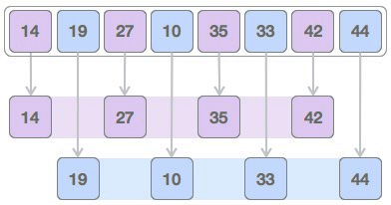
Shell Sort
How do insertion sort and selection sort work?
Keep an “invisible wall” between the sorted and unsorted part
Insertion sort removes elements from unsorted, inserting them into the correct location in sorted
Selection sort swaps the smallest element in unsorted with the element at the head of unsorted, moving it into sorted
The shell sort algorithm
Uses comb sort’s idea: Use a variable gap to create sub-arrays
Sort sub-arrays using any algorithm, decrease gap, until sorted
44
45
46
48
43
12
Sorted
Unsorted

Slide 5
Shell Sort
Let’s look at an example
n = 6
Choose an initial gap = 3
Find sub-arrays
Apply a sorting algorithm to every sub-array
Use any sorting algorithm
Insertion sort is very commonly used, so we’ll do the same for this example
Shrink the gap until gap = 1
3
6
2
8
1
5
3
8
6
1
2
5
3
1
2
8
6
5

Slide 6
Shell Sort
Moving on to the second pass
We’ll reduce the gap by 1 for this example
gap = 2
Find sub-arrays
Apply insertion sort to sub-arrays
Now for the final pass
gap = 1
We’re now working with the full array
Apply insertion sort
We performed a single move on the last iteration!
3
1
2
8
6
5
3
2
6
1
8
5
2
1
3
5
6
8

Slide 7
Shell Sort: Efficiency
Iterate through all the gaps
How do we choose the gaps?
If the gaps decrease linearly
n-1, … , 3, 2, 1
How many times will the outer loop execute?
Even if the inner algorithm improves from O(n²) to O(n), complexity of the outer loop will bring it back to O(n²)
Gaps must decrease non-linearly!
Divide by a factor
Hard-code a sequence of gaps
for (gap = initialValue; gap >= 1; gap = shrinkGap(gap)){
for (p = 0; p < gap; p++) {
// insert your favourite algorithm here to
// sort each sub-array starting at index p
}
}
Generate all the sub-arrays
O(n²), but will improve significantly thanks to sorting of sub-arrays
Best case:
O(n lg n)
Worst case:
O(n lg² n )

Slide 8
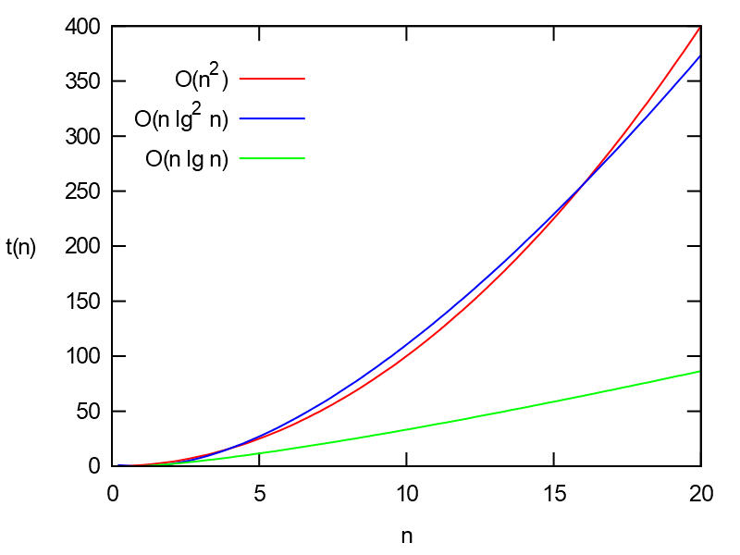
Shell Sort: Efficiency

Slide 9
Revisiting Selection Sort
selectionSort(data[ ])
for i = 0 to data.length-1
select the smallest element among
data[i], ... , data[data.length-1];
swap it with data[i];
Selection | Best | Average | Worst
Comparisons | O(n²) | O(n²) | O(n²)
Movements | 0 | O(n) | O(n)
Why is selection sort slow?
We have to search for the smallest element at every outer loop iteration
What if we had direct access to the smallest element?
Do you recall any data structure that allows exactly that?
Yes! Heaps
Min-heap: The smallest element is always at the top
Max-heap: The largest element is always at the top
Heaps are especially appropriate for sorting
They can be stored in arrays

Slide 10
Heap Sort
Phase 1: Transform data into a max-heap
Phase 2: The sorting procedure
The opposite of classic selection sort (i.e. sorted part is on the right)
Start with entire array in unsorted part
Swap root (largest element in the heap) with last value in unsorted
This removes root from heap, adding it to the left of the sorted part
Thus the heap shrinks as the sorted part grows
Finally, restore the heap in the unsorted part, and repeat
The result of this heap sort
Array in ascending order
What if you wanted descending order instead?
heapsort(data[])
transform data[] into a max-heap; // Floyd’s algorithm
for i = data.length-1 down to 2
swap the root with the element in position i;
restore heap property for the tree data[0], ... , data[i-1];

Slide 11
Heap Sort
Phase 1: Transform data into a max-heap
Floyd’s algorithm
Start with the last non-leaf node
While the non-leaf node has a smaller value than any of its children
Swap the non-leaf node with the largest of these children
Stop if no larger valued children found, or non-leaf node becomes a leaf
Continue with the previous non-leaf node
Efficiency is O(n)
FloydAlgorithm(data[])
i = index of the last nonleaf
while i >= 0
p = data[i];
while p is not a leaf and p < any of its children
swap p with the larger child;
i = i--; // index of the previous non-leaf

Slide 12
Heap Sort
Phase 1: Transform data into a max-heap (Floyd’s algorithm)
4
6 3
7 5 4
3
7 5 4
7 5
4
3
6
4 | 6 | 3 | 7 | 5 | 4
4 | 6 | 3 | 7 | 5 | 4
4 | 6 | 4 | 7 | 5 | 3
Last nonleaf
4
7
4 4
6 5 3
7
6 4
4 5 3
7
6 5
4
3
4 | 7 | 4 | 6 | 5 | 3
7 | 4 | 4 | 6 | 5 | 3
7 | 6 | 4 | 4 | 5 | 3

Slide 13
Heap Sort
Phase 2: The sorting procedure
Dequeuing algorithm
Swap largest element (always at data[0]) with last leaf (at data[i])
Both are efficient to work with, due to direct access
Restore the heap property
Set p to the root of the heap
While p is less than any of its children, swap p with its largest child
Efficiency is O(lg n)
for i = data.length-1 down to 2
swap the root with the element in position i;
p = the root;
while p is not a leaf and p < any of its children
swap p with the larger child;

Slide 14
Heap Sort
Phase 2: The sorting procedure
7
6 4
4 5 3
3
6 4
4 5 7
6
3 4
4 5
6
5 4
4 3
7 | 6 | 4 | 4 | 5 | 3
3 | 6 | 4 | 4 | 5 | 7
6 | 3 | 4 | 4 | 5 | 7
6 | 5 | 4 | 4 | 3 | 7
3
5 4
4 6
5
3 4
4
5
4 4
3
3
4 4
5
3 | 5 | 4 | 4 | 6 | 7
5 | 3 | 4 | 4 | 6 | 7
5 | 4 | 4 | 3 | 6 | 7
3 | 4 | 4 | 5 | 6 | 7

Slide 15
Heap Sort
3
4 4
5
4
3 4
4
3 4
4
3
3
4
3 | 4 | 4 | 5 | 6 | 7
4 | 3 | 4 | 5 | 6 | 7
4 | 3 | 4 | 5 | 6 | 7
4 | 3 | 4 | 5 | 6 | 7
3 | 4 | 4 | 5 | 6 | 7

Slide 16
Heap Sort
Efficiency of heap sort?
O(n)
heapsort(data[])
transform data[] into a heap; // Floyd’s heapifying algorithm
for i = data.length-1 down to 2
swap the root with the element in position i;
restore the heap property for the tree data[0], …, data[i-1];
O(n)
Best case:
O(n lg n)
Worst case:
O(n lg n )
O(lg n)
Average case:
O(n lg n )

